Slide 1
Developing Microsoft SQL Server Databases
Christian Bolton | Technical Director, Coeo
Graeme Malcolm | Microsoft

Slide 2
Course Topics
Developing Microsoft SQL Server Databases
01 | Implementing Tables & Views | 06 | Optimizing & Troubleshooting Queries
02 | Understanding Indexes
03 | Using Stored Procedures & Functions
04 | Managing Transactions
05 | Implementing In-Memory Objects

Slide 3
06 | Optimizing & Troubleshooting Queries
Christian Bolton | Technical Director, Coeo
Graeme Malcolm | Microsoft

Slide 4
Module Overview
SQL Server Waits
Joining too many tables
Other performance tips

Slide 5

SQL Server Waits Architecture
SQL Server has a co-operative scheduler
Windows has a pre-emptive scheduler

Session
Task
☑
☑
☑
Scheduler
Co-Operative Scheduling
Logical CPU

Slide 6

SQL Server Waits Architecture
SQL Server “wait”
Running Scheduler 1
Suspended Scheduler 1
55 Running
52 PAGEIOLATCH_SH
Runnable Scheduler 1
54 CXPACKET
53 Runnable
60 LCK_M_S
56 Runnable
61 LCK_M_S
59 Runnable
52 Runnable
Signal Wait

Slide 7
Useful Wait Types
PAGEIOLATCH
CXPACKET
WRITELOG
LCK_M_*
PREEMPTIVE_*

Slide 8
DMVs to View Wait Information
sys.dm_exec_requests
Session level only
sys.dm_os_waiting_tasks
Task level
Very accurate
Transient data
sys.dm_os_wait_stats
Cumulative waits by wait type
Persistent data

Slide 9
SQL Server wait DMVs

Slide 10
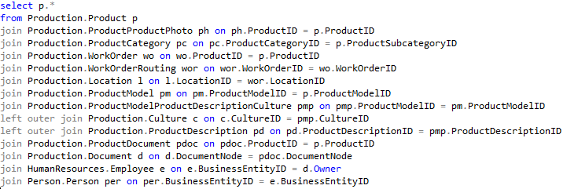
Slow query

Slide 11
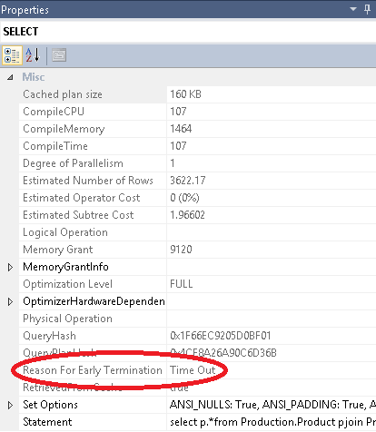
Slow Query

Slide 12
Join Order
The optimizer can choose to join
Customer -> Order
Order -> Customer
The number of choices increases exponentially with more joins
The order in which joins happen is important

Slide 13
Join Order
Possible permutations:
(Customer -> Order) -> Product
(Order -> Customer) -> Product
Product -> (Customer-> Order)
Product -> (Order -> Customer)
Customer -> (Order -> Product)
Customer -> (Product -> Order)

Slide 14
Join Order
There are n! possible permutations
Where n is the number of tables in the statement
With 10 tables, there are 3,628,800 permutations
With 14 tables, there are over 86 BILLION permutations
This is even before the optimizer has had a chance to evaluate data access methods, join algorithms etc
The optimizer has to evaluate plans in a reasonable amount of time and will time out keeping the best plan it had found up to then
The same plan won’t be guaranteed

Slide 15
Help the Optimizer
Simplify the query
6 joins has over 700 permutations
7 joins has over 5000 permutations
Consider the database design

Slide 16
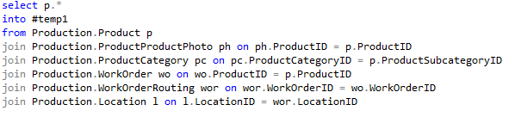
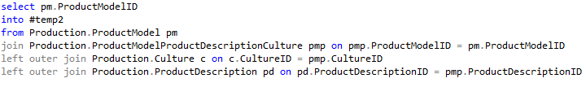


Simplify the Query

Slide 17
Other performance tips
Make sure your variables and column names have identical data types
Avoid the use of Scalar UDFs in a WHERE clause
Don’t create massive decision trees in a stored procedures
Use separate stored procedures to get better plan re-use

Slide 18
Optimizing and Troubleshooting Queries
Summary
SQL Server Waits
Joining too many tables
Other performance tips

Slide 19
Developing Microsoft SQL Server Databases
Implementing Tables & Views
Understanding Indexes
Using Stored Procedures & Functions
Managing Transactions
Implementing In-Memory Objects
Optimizing & Troubleshooting Queries

